Slide 1
Lesson3: Linear Models
Instructor: Xiang Deng
2025.10.10

Slide 2
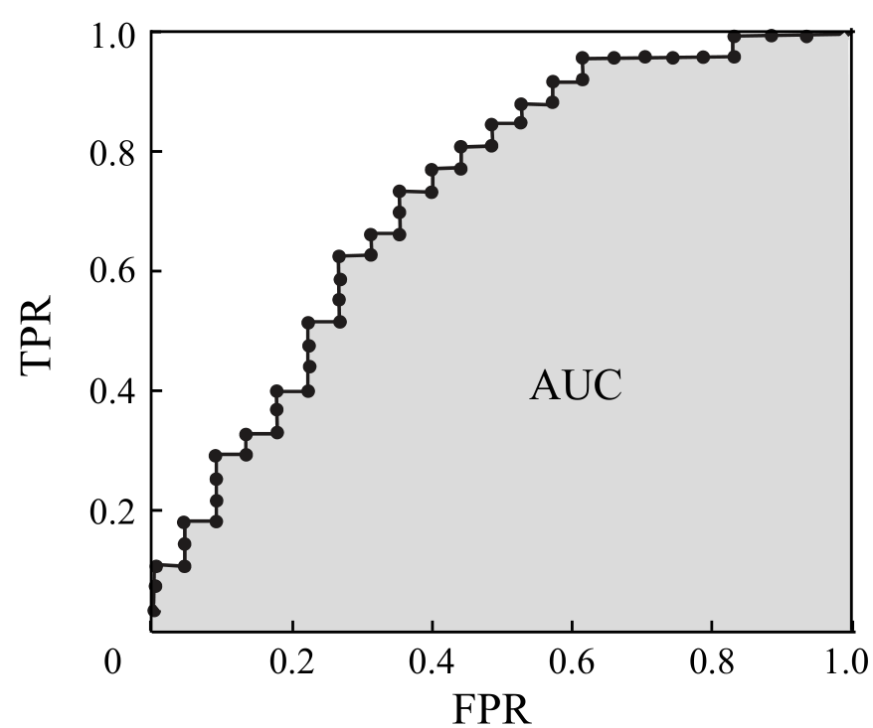
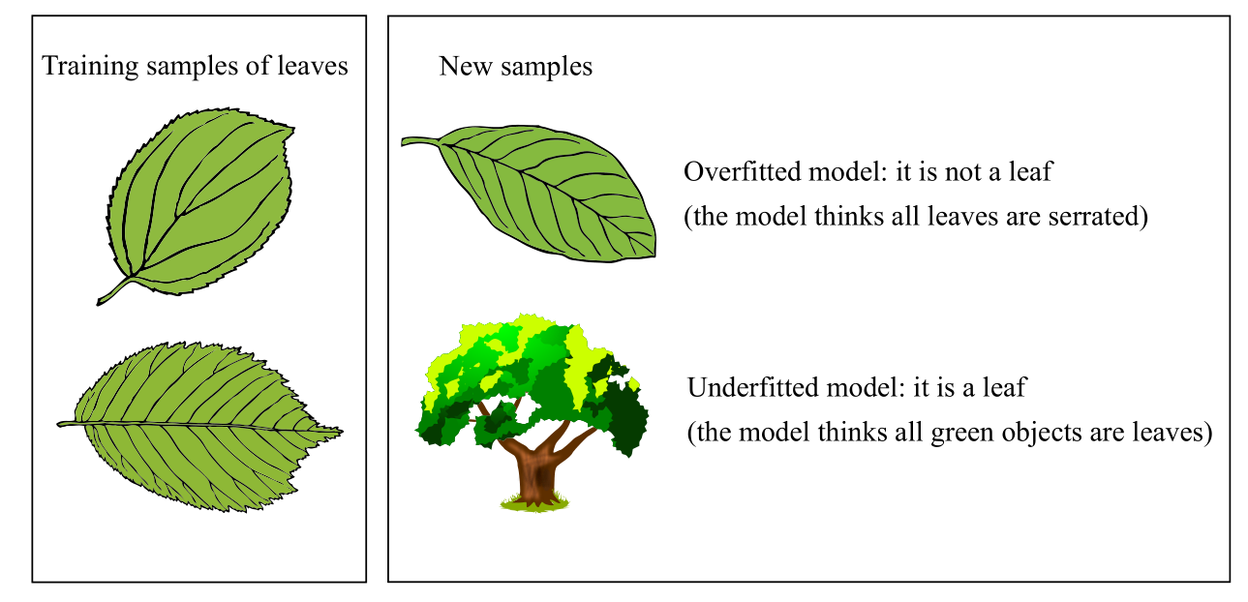
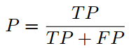
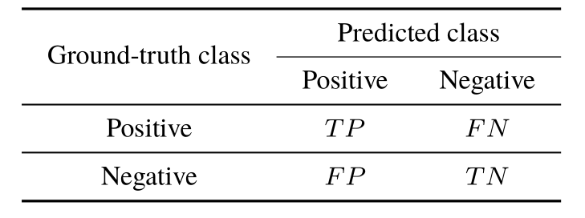
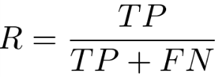
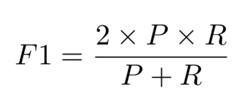
review
Empirical Error and Overfitting: overfitting, underfitting
Evaluation methods: generalization error, Hold-out, Cross-Validation, Bootstrapping
Performance Measure: Mean Squared Error, Error rate, accuracy, Precision, recall, f1, P-R curve, break-even points, ROC curve and AUC, cost-sensitive error rate
Performance Comparisons: Hypothesis testing
Bias and Variance: the generalization error can be decomposed into the sum of bias, variance, and noise.
The confusion matrix of binary classification
Precision
Recall

Slide 3
Outline
Linear Regression
Least Squares Method
Binary Classification Problem
Logistic Regression
Linear Discriminant Analysis
Multiclass Classification Problem
One vs. One (OvO)
One vs. Rest (OvR)
Many vs. Many (MvM)
Class Imbalance Problem

Slide 4
The Basic Form
The Basic form of the linear model
is a sample where takes the value on the -th variable.
The vector form
where

Slide 5
Advantages of the Linear Model
Simple form and ease of modeling
Comprehensibility
Nonlinear models can be derived from linear models
Introducing multi-layer structures or high-dimensional mapping.
An example
Determine the ripeness of a watermelon by considering its color, root and sound information.
From the coefficients, we know that root is the most important variable, and sound is more important than color.

Slide 6
Linear Regression
Given a data set
where
The aim of linear regression
Learn a linear model that can accurately predict the real-valued output labels
For discrete variables
An ordinal relationship exists between values
Convert the variables into real-valued variables
No ordinal relationship exists
Convert the discrete variable with k possible values into a k-dimensional vector

Slide 7
Linear Regression
Linear regression aims to learn the function:
Parameter/model estimation: least square method

Slide 8
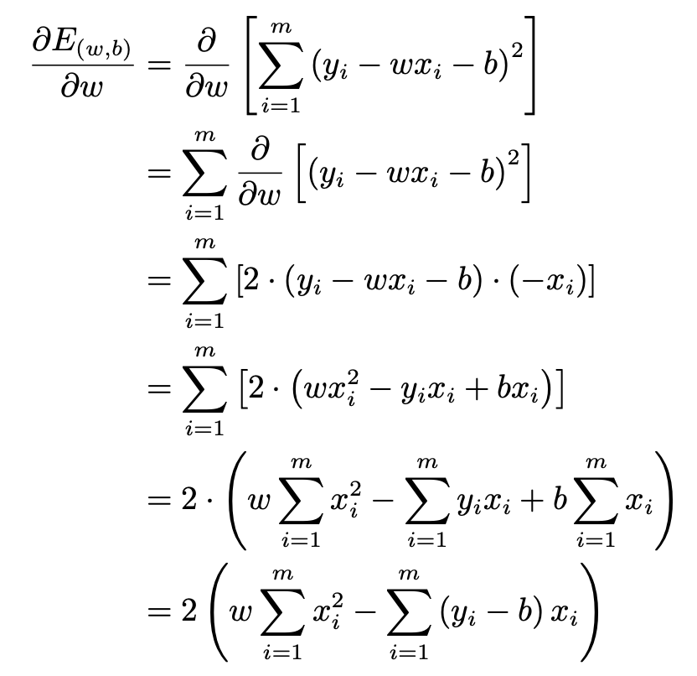
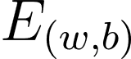
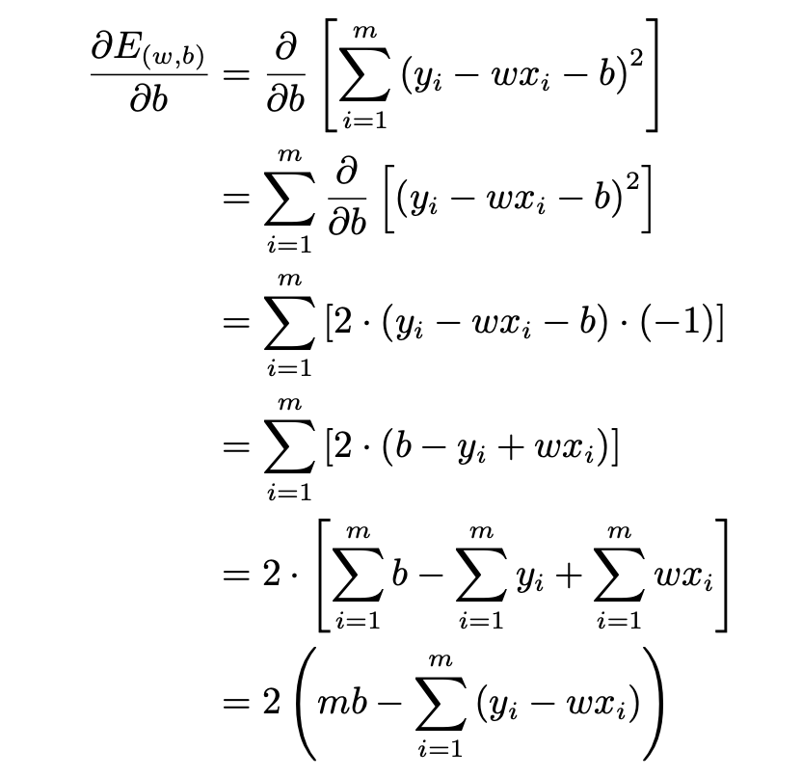
Linear Regression - Least Square Method
Minimize mean-square error (MSE)
Calculate the derivatives of with respect to and , respectively:

Slide 9
Linear Regression - Least Square Method
convex function
We have the closed-form solutions
(derivatives w.r.t. w and b equal to 0) :
where
How are they obtained?

Slide 10
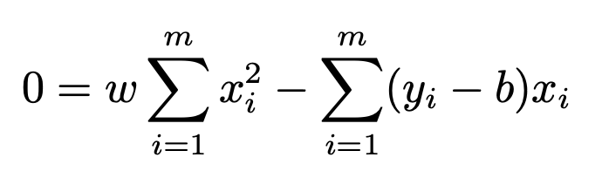
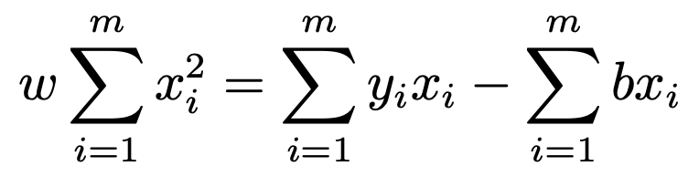
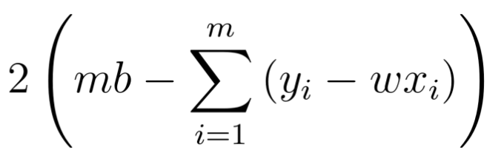
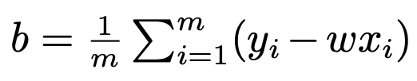
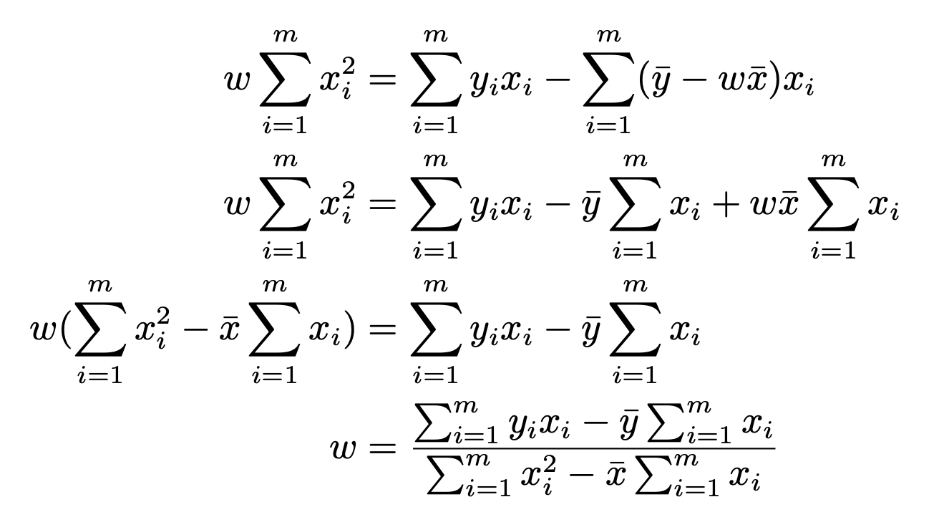
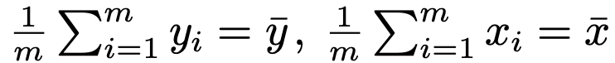
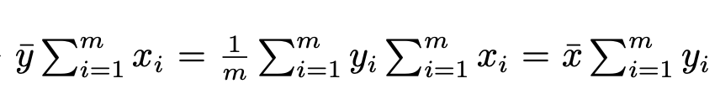
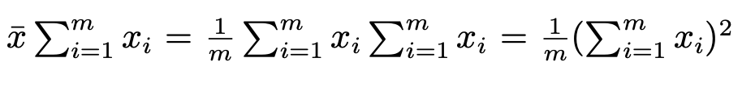
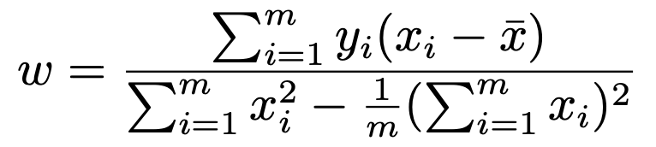
Linear Regression - Least Square Method
0=

Slide 11
Multivariate Linear Regression
Given a data set
The objective function of multivariate linear regression
such that

Slide 12
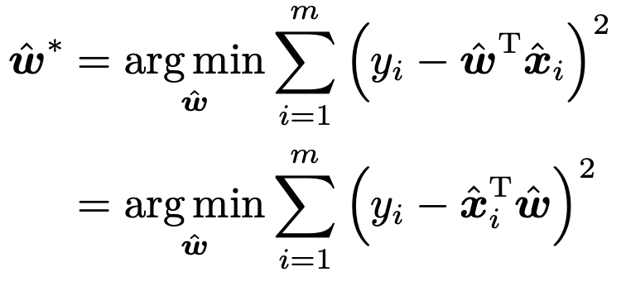
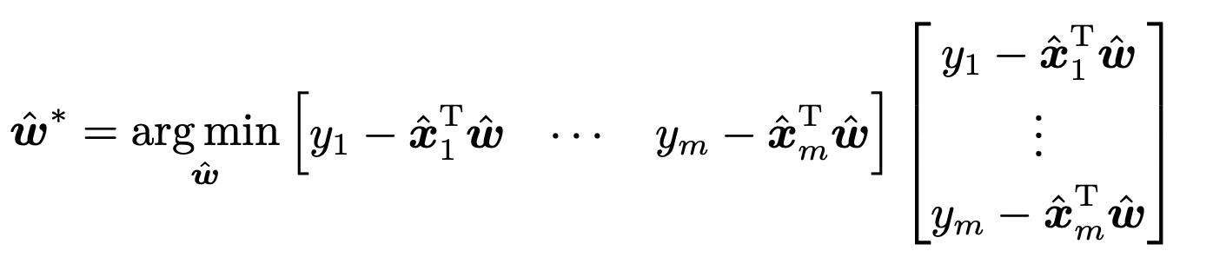
Multivariate Linear Regression
Rewrite
Least square method

Slide 13
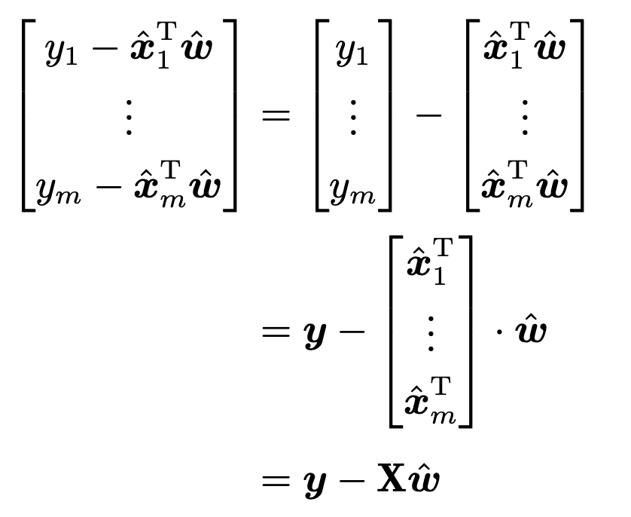
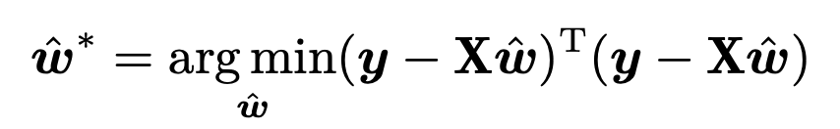
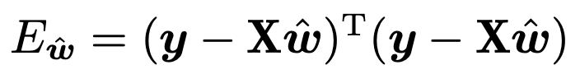
Multivariate Linear Regression
Let and find the derivative with respect to

Slide 14
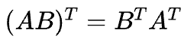
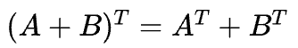
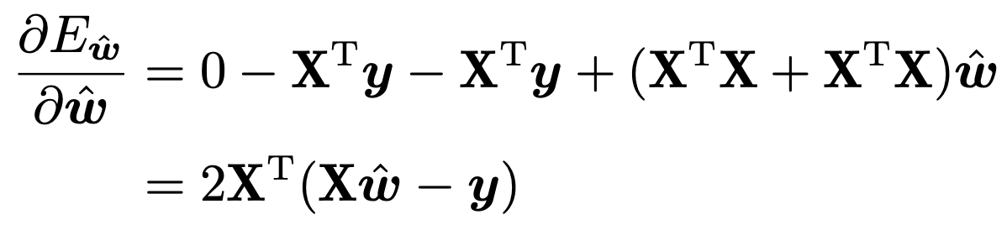
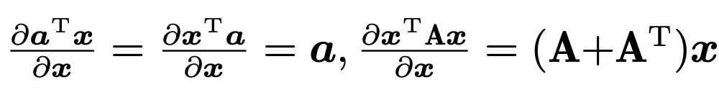
Multivariate Linear Regression - Least Square Method
The derivative with respect to
Recall Matrix transpose:
Recall Matrix Differentiation:
The closed-form solution of can be obtained by making the equation equal to 0.

Slide 15
Multivariate Linear Regression - Discussion of full-rank
is a full-rank matrix or a positive definite matrix, then by making the above equation equal to 0:
where is the inverse of , the learned multivariate linear regression model is
is often not full-rank
introducing regularization.

Slide 16
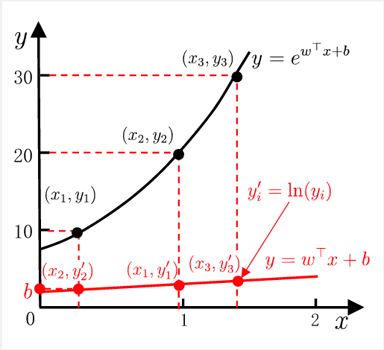
Log-Linear Regression
The logarithm of the output label can be used for approximation

Slide 17
Linear Regression - Generalized Linear Model
The general form
Where the function is the link function.
a monotonic differentiable function
Log-linear regression is a special case of generalized linear models when

Slide 18
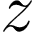
Binary Classification
The predictions and the output labels
The real-valued predictions of the linear regression model need to be converted into 0/1.
Ideally, the unit-step function is desired
which predicts positive for greater than 0, negative for smaller than 0, and an arbitrary output when equals to 0.

Slide 19
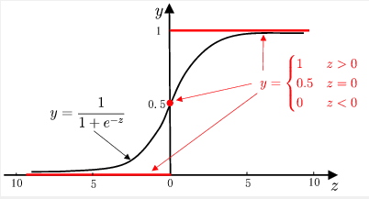
Binary Classification
Disadvantages of unit-step function
not continuous
Logistic function: a surrogate function to approximate the unit-step function
monotonic differentiable
Comparison between unit-step function and logistic function

Slide 20
Logistic regression
Apply logistic function
Log odds
the logarithm of the relative likelihood of a sample being a positive sample
Logistic regression has several nice properties
without requiring any prior assumptions on the data distribution
it predicts labels together with associated probabilities
it is solvable with numerical optimization methods.
transform into

Slide 21
Logistic regression - maximum likelihood
Log odds can be rewritten as

Slide 22
Logistic regression - maximum likelihood
Maximum likelihood
Given a data set
Maximizing the probability of each sample being predicted as the ground-truth label
the log-likelihood to be maximized is

Slide 23
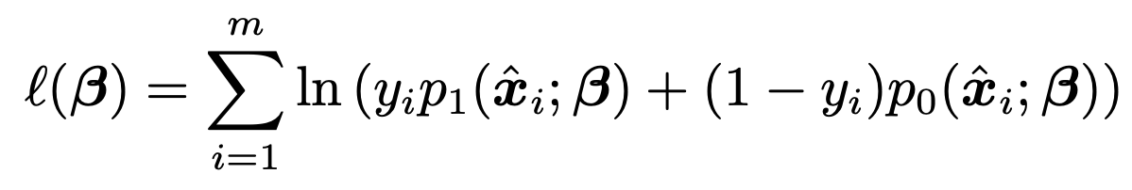
Logistic regression - maximum likelihood
Transform into minimize negative log-likelihood
Let ， ， can be rewritten as
Let
the likelihood term in can be rewritten as
the log-likelihood can be written:

Slide 24
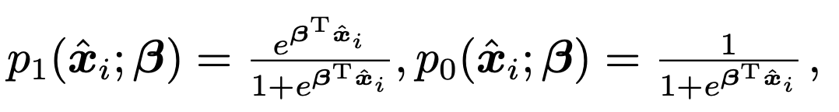
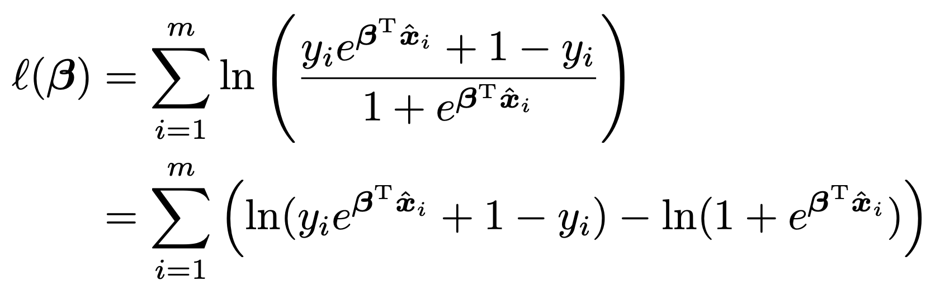
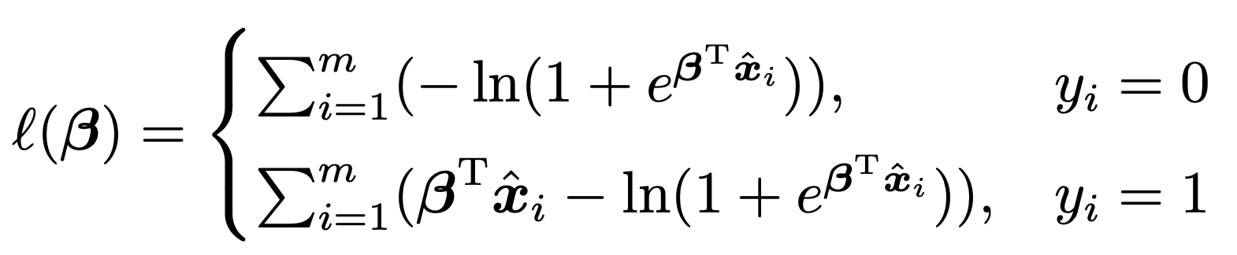
Logistic regression - maximum likelihood
since
y_{i} can be 0 or 1:

Slide 25
Logistic regression
We have
Taking Newton’s method as an example, the update rule at the (t+1)th iteration is
Need to calculate the first- and second-order derivatives with respect to
higher order differentiable convex function, gradient
descent method / Newton’s method [Boyd and Vandenberghe, 2004]

Slide 26
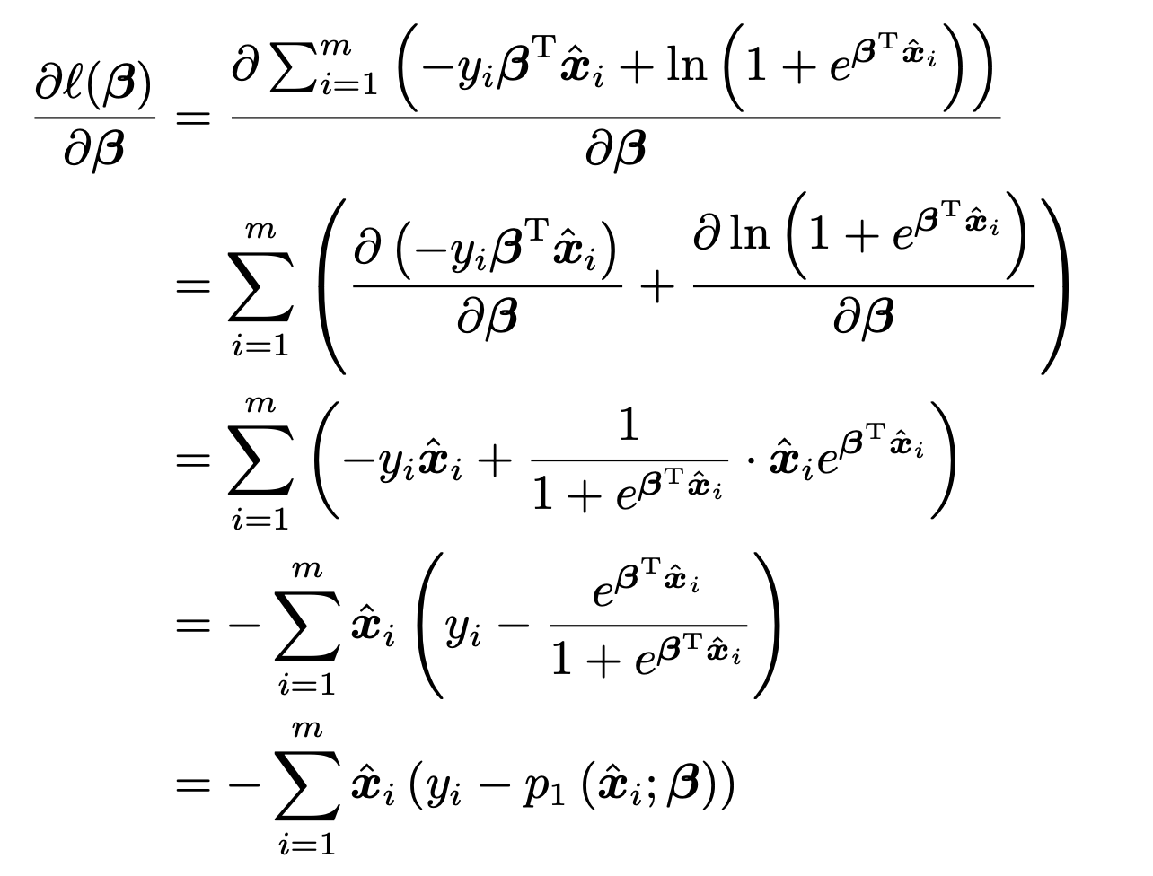
Logistic regression
the first-order derivatives with respect to are

Slide 27
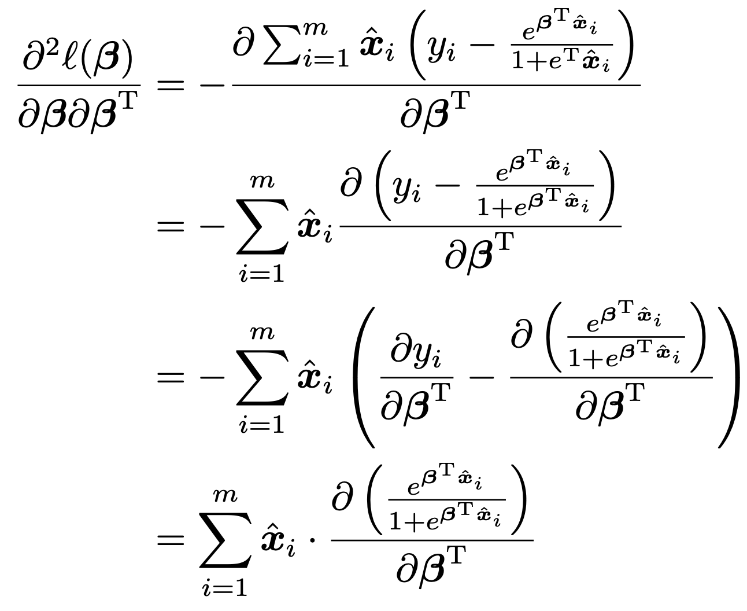
Logistic regression
the second-order derivatives with respect are

Slide 28
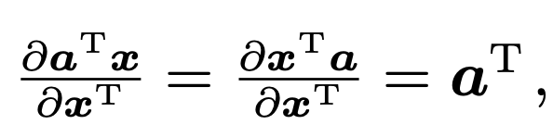
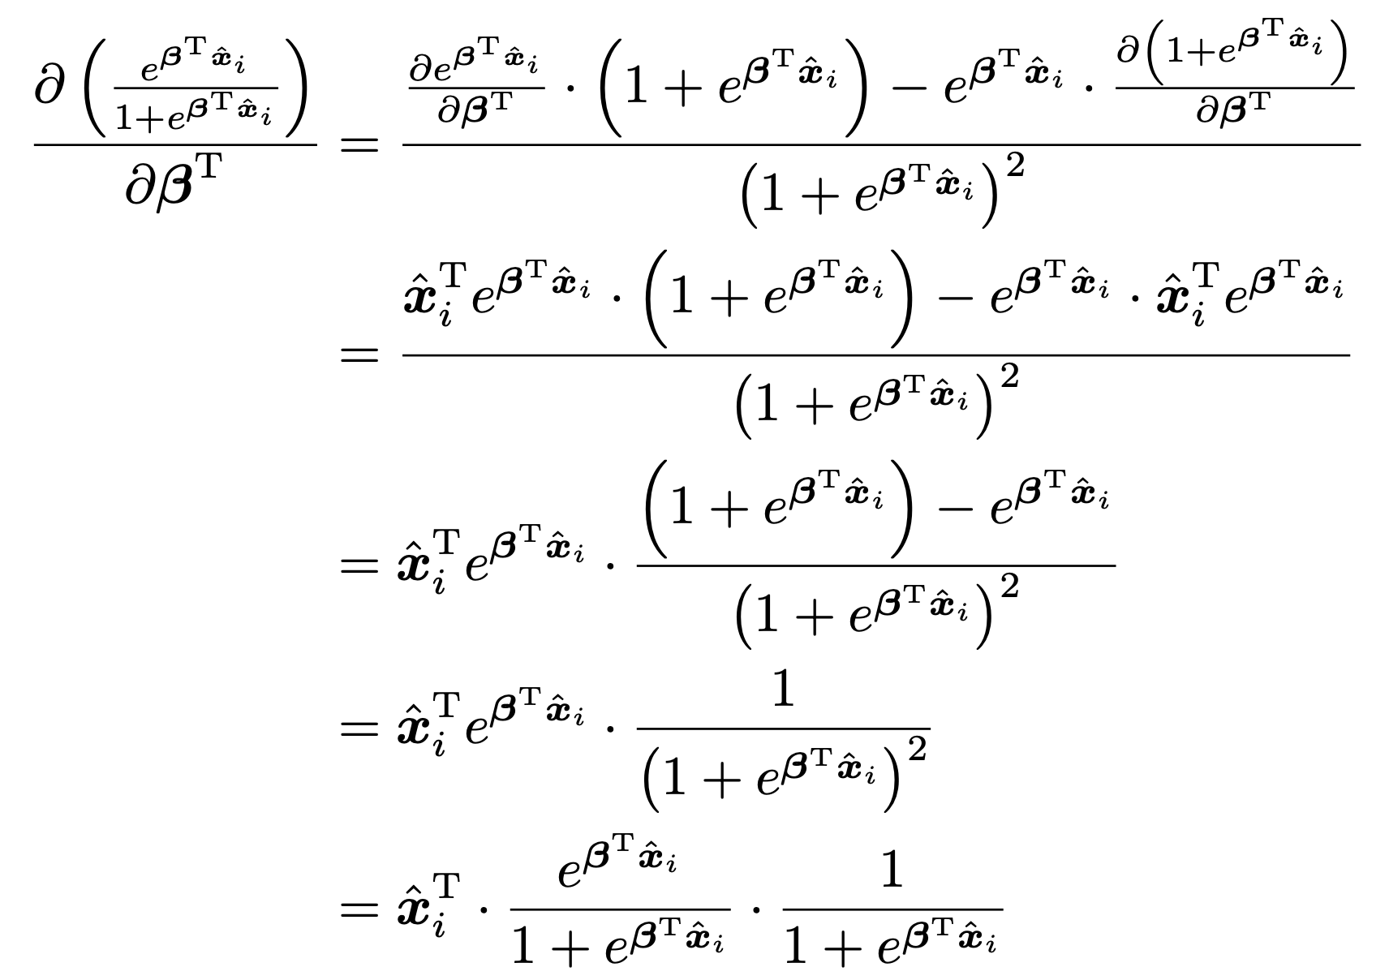
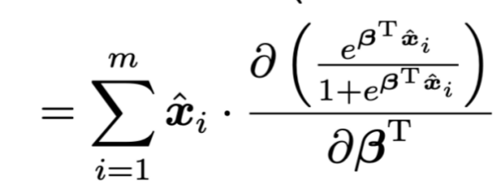
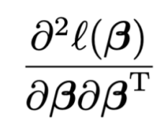
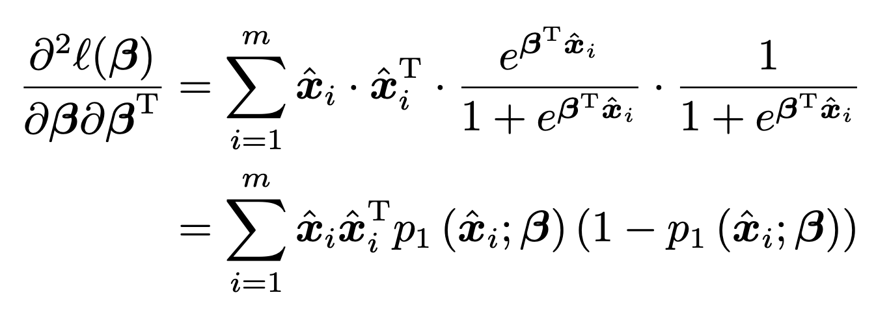
Logistic regression
according to matrix differential formulas
numerator
denominator
numerator
denominator
from the previouse slide:
natural constant‌

Slide 29
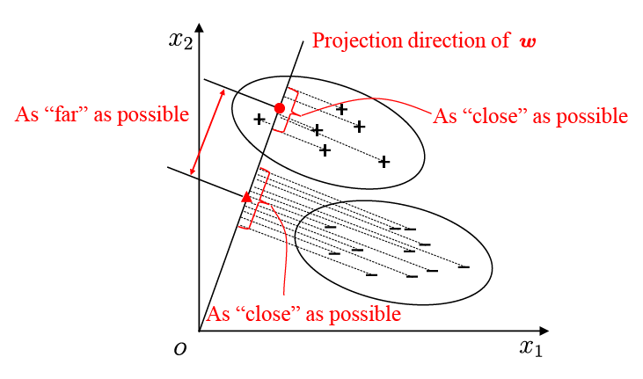
Binary Classification - Linear Discriminant Analysis
Linear Discriminant Analysis [Fisher, 1936]
LDA is also considered as a classic supervised dimensionality reduction technique

Slide 30
Binary Classification - Linear Discriminant Analysis
The idea of LDA: project the same class samples onto a line, while samples of different classes are far away from each other.
To make the projection points of similar samples as close as possible, we can make the covariance of the projection points of similar samples as small as possible
To make the projection points of examples from different classes as far away as possible, we can make the distance between the class centers as large as possible
Some variables
the sample set of the -th class
the mean vector of the -th class
the covariance matrix of the -th class
the centers of those two classes samples and
the covariances of the two classes samples and

Slide 31
Binary Classification - Linear Discriminant Analysis
We have the objective to be maximized
The within-class scatter matrix
The between-class scatter matrix
To make the projection points of similar samples as close as possible, we can make the covariance of the projection points of similar samples as small as possible.
To make the projection points of examples from different classes as far away as possible, we can make the distance between the class centers as large as possible

Slide 32
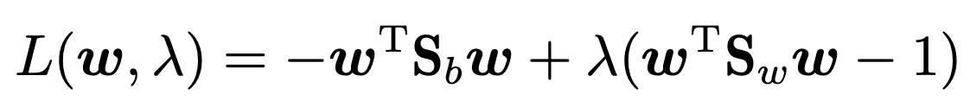
Binary Classification - Linear Discriminant Analysis
Generalized Rayleigh quotient
Let , maximizing generalized Rayleigh quotient is equivalent to
Using the method of Lagrange multipliers

Slide 33
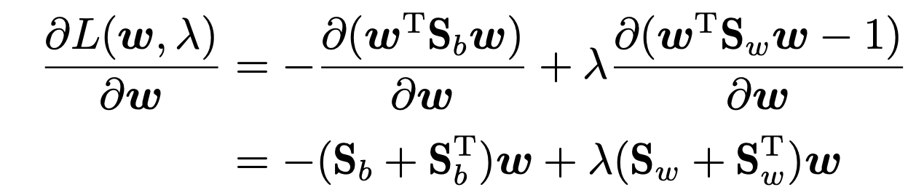
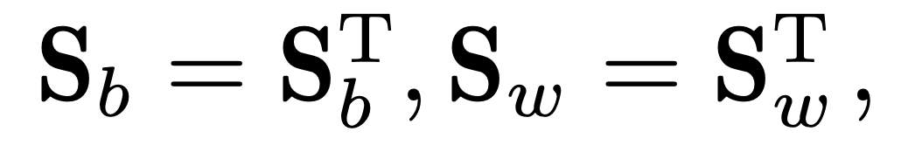
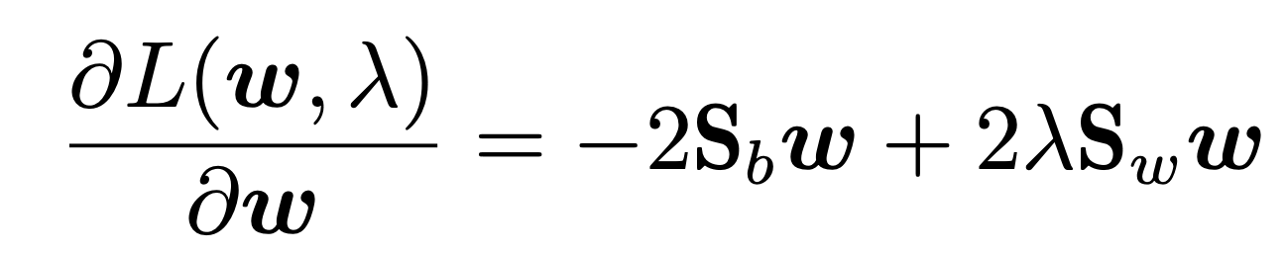
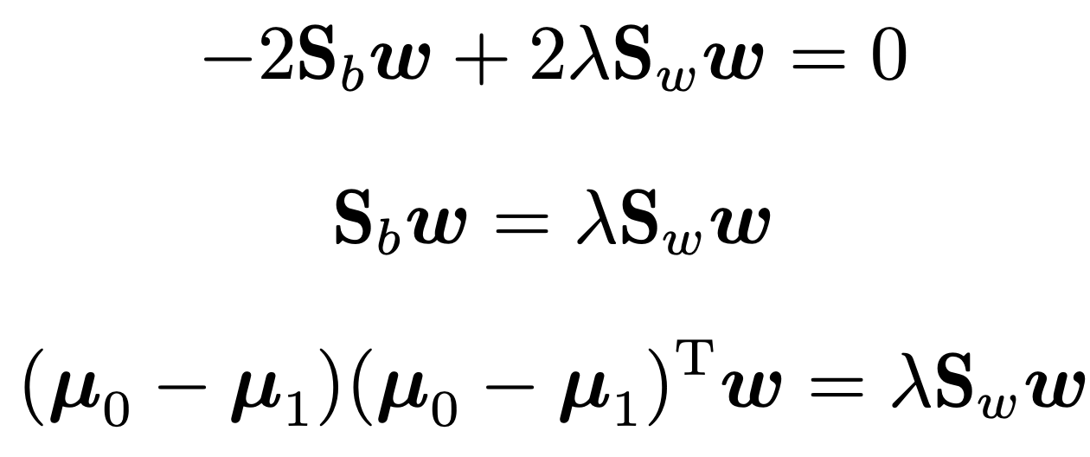
Binary Classification - Linear Discriminant Analysis
the derivatives are:
since
Let it be 0:

Slide 34
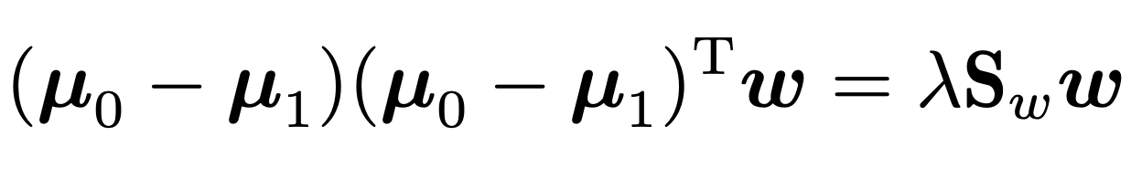
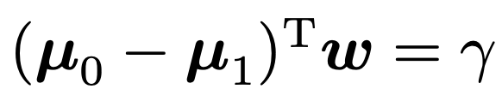
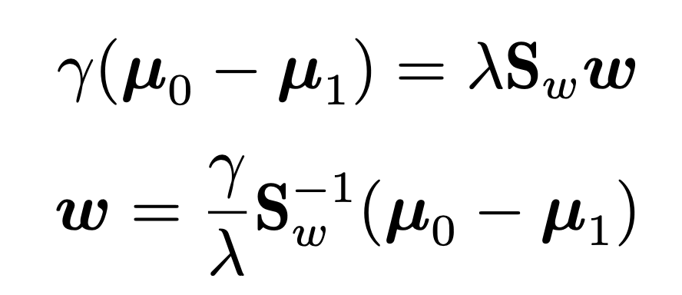

Binary Classification - Linear Discriminant Analysis
Let
:
Since the final solution of w only concerns its direction rather than its magnitude, its magnitude can be assigned arbitrarily. Moreover, as µ₀ and µ₁ have fixed magnitudes, is affected only by the magnitude of w. Therefore, by adjusting the magnitude of w, we can make = λ.
It finally gives:

Slide 35
Extend LDA to multiclass classification problems
The global scatter matrix
The within-class scatter matrix
where
We have

Slide 36

Extend LDA to multiclass classification problems

Slide 37




Extend LDA to multiclass classification problems
Objective
where
Concatenating the eigenvectors corresponding to the largest non-zero eigenvalues of leads to the closed-form solution of , where
Since the projection reduces the data while considering the class information, LDA is also considered as a classic supervised dimensionality reduction technique

Slide 38
Multiclass Classification
Multiclass Classification learning methods
Some binary classification methods can be directly extended to accommodate multiclass cases
Apply some strategies to solve multiclass classification problems with any existing binary classification methods（more general）
Decompose the problem and then train a binary classifier for each divided binary classification problem
Ensemble the outputs collected from all binary classifiers into the final multiclass predictions
Dividing strategies
One vs. One (OvO)
One vs. Rest (OvR)
Many vs. Many (MvM)

Slide 39
Multiclass Classification - OvO
In the decomposing phase
puts the N classes into pairs
N(N-1)/2 binary classification tasks
trains a classifier for each task
N(N-1)/2 classifiers
In the testing phase
a new sample is classified by all classifiers
N(N-1)/2 classification outputs
the final prediction can be made via voting
the predicted class is the one received the most votes

Slide 40
Multiclass Classification - OvR
In the decomposing phase
consider each class as positive in turn, and the rest classes are considered as negative
N binary classification tasks
trains a classifier for each task
N classifiers
In the testing phase
a new sample is classified by all classifiers
N classification outputs
the prediction confidences are usually assessed
the class with the highest confidence is used as the classification result

Slide 41

Multiclass Classification – A comparison between OvO and OvR

Slide 42
Multiclass Classification – A comparison between OvO and OvR
OvO
OvR
Train N(N-1)/2 classifiers，the memory and testing time costs are often higher
Each classifier uses only samples of two classes. Hence, the computational cost of training OvO is lower
Train N classifiers，the memory and testing time costs are often lower
Each classifier uses all training samples. Hence, the computational cost of training OvO is higher
As for the prediction performance, it depends on the specific data distribution, and in most cases, the two methods have similar performance.

Slide 43
Multiclass Classification - MvM
Many vs Many(MvM)
MvM conducts multiple trials, and each trial puts several classes as positive and several classes as negative.
Error Correcting Output Code, ECOC
A total of M training sets are
Generated. The base codeword of each class are calculated.
Encoding: split the N classes M times, where each time splits some classes as positive and some classes as negative.
The class with the shortest distance is returned as the final prediction.
Decoding: use the M classifiers to predict a testing sample
Combine the predicted labels into a codeword

Slide 44

Multiclass Classification - MvM
Deactivated class, Hamming distance is 0.5 not 1
Error Correcting Output Code, ECOC
[Dietterich and Bakiri,1995]
[Allwein et al. 2000]
The ECOC codeword has the error tolerance and correction ability. a longer ECOC codeword produces better correction ability
In theory, the correction ability of a fixed length codeword increases as the distances between classes increase.

Slide 45
Class Imbalance Problem
Class imbalance
a significantly different number of samples for each class.（the positive class is the minority）
Rescaling
undersampling
some negative samples are selectively dropped so that the classes are balanced (EasyEnsemble [Liu et al.,2009])
oversampling
increase the number of positive samples so that the classes are balanced (SMOTE [Chawla et al.2002])
threshold-moving
the classes are balanced
the observed class ratio

Slide 46
Summary
The objective of optimization of each model
Least squares method: Minimize the mean-square error
Logistic regression: Maximizing the likelihood of sample distribution
Linear discriminant analysis: minimize the within-class scatter matrix and maximize the between-classes scatter matrix
Optimization method of parameters
Least squares method: Linear Algebra
Logistic regression: convex optimization, Newton's method
Linear discriminant analysis: matrix theory, generalized Rayleigh quotient

Slide 47
Summary
Linear Regression
Least Squares Method (minimize the mean-square error)
Binary Classification Problem
Logistic Regression
Unit-step function, logistic function, maximum likelihood method
Linear Discriminant Analysis
Maximizing generalized Rayleigh quotient
Multiclass Classification Problem
One vs. One (OvO)
One vs. Rest (OvR)
Many vs. Many (MvM)
Error Correcting Output Code
Class Imbalance Problem
Strategy: rescaling

Slide 48
Thanks!

